Slide 1
HONORS DAY 2019
HONOREES

Slide 2
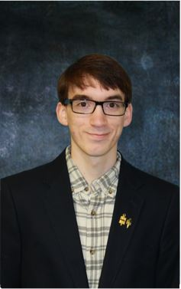
TRISTAN ANDREWS
Outstanding student in the field of Literature
All Alabama Team Representative
Phi Theta Kappa President
University of Alabama Presidential Scholarship recipient
University of Alabama All Alabama Academic Team Scholarship recipient
University of Alabama Supply Store Book Scholarship recipient
“I will transfer to the University of Alabama to earn a bachelors in History. I would like to work at museums or in archaeological research."

Slide 3
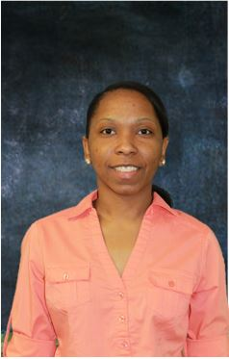
MEGAN BRAFORT
Outstanding student in the field of:
Engineering Graphics and Animation
“I plan to open up my own group homes, foster homes, and a traveling organization for troubled teens in the cities where crime is the highest ."

Slide 4
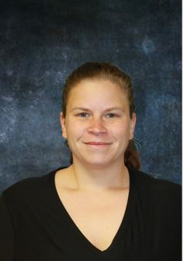
THEA BROWN
Association of Student Practical Nurses Vice President

Slide 5
EVELYN BURRELL
Outstanding student
in the field of
Licensed Practical Nursing
“ I plan to continue my education at Wallace. My career goal is to become a wound care Nurse."

Slide 6
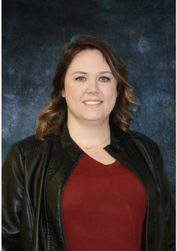
STEPHANIE BURZYNSKI
Association of Student Practical Nurses Secretary

Slide 7
ALTHEA CAMPBELL-WILLIAMS
Outstanding student
in the field of
Computer Information Science

Slide 8
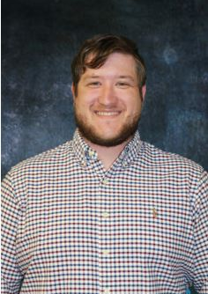
ANDREW CHAPMAN
Bass Fishing Club
Tournament Director

Slide 9
HANNAH DAVIS
Outstanding student in
Business Technologies

Slide 10
HEATHER
DAVIS
Student Government Association President
“

Slide 11
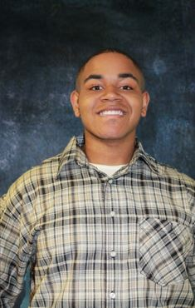
ERIC DECREE
Outstanding student in the field of Engineering Graphics and Animation
“In the fall I plan to attend Auburn University to obtain a bachelors degree in Graphic Design. My career goal is to do 3-D design and open an art gallery."

Slide 12
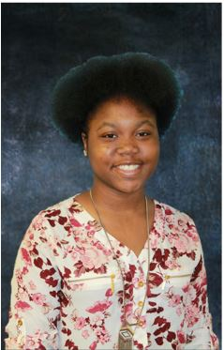
KADAIJA
DORTCH
Outstanding student in the field of Psychology Human Growth and Development
“In the future I will major in either Criminal Justice or Cosmetology. I plan on completing my general courses while I decide on my career goal.”

Slide 13
LILLIAN
FLOWERS
Student Government Association Secretary
“I plan to attend Troy University fall 2019 and major in Business Administration with a concentration in Human Resources Management and minor in Spanish. My career goal is to gain employment with a corporate business.”

Slide 14
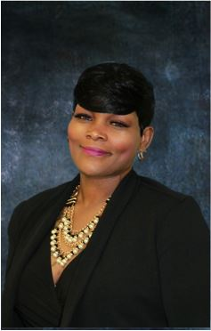
BEVERLY GAMBLE
Outstanding student in the field of Criminal Justice
“I plan on earning an Associates degree from Wallace and then transferring to a University. My career goal is to become a parole officer.”

Slide 15
MICHAEL
GARY
Student Government Association Activities Coordinator
“

Slide 16
LOGAN
GRUBBS
Outstanding student in the field of Applied Engineering
“

Slide 17
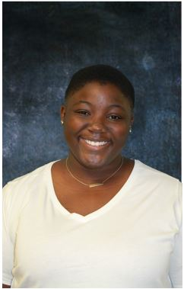
KAYLA HALL
Outstanding student in Speech
“I will be completing my Associates degree in Business summer 2019. I will attend Troy University fall 2019 and major in Business Management."

Slide 18
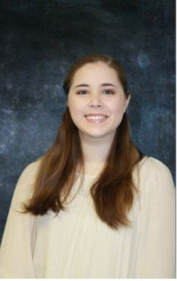
EMILY HOLLAND
Phi Theta Kappa Secretary
University of Alabama Community of Excellence scholarship recipient
Troy University Transfer Merit scholarship recipient
“I will transfer to the University of Alabama to earn a bachelors in Microbiology. My career goal is to conduct medical research."

Slide 19
MICHAEL HUDSON
Outstanding student in the field of:
Criminal Justice

Slide 20
DANIEL INGRAM
Outstanding student in the field of Air Conditioning and Refrigeration

Slide 21
TYIANNA
JACKSON
Outstanding student in the field of Business Technologies

Slide 22
HUNTER KEITH
Outstanding student in the field of Principles of Biology
Outstanding student in the field of Math
“

Slide 23
NOAH KELLY
Phi Theta Kappa Vice President

Slide 24
THOMAS
KILLINGWORTH
Outstanding student in the field of Math

Slide 25
LENADA LYNN
Outstanding student in Licensed Practical Nursing

Slide 26
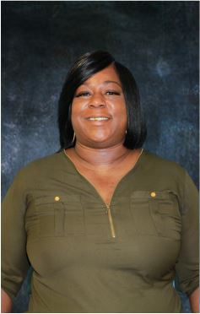
KAREN MARSHALL
Outstanding student in the field of Welding Technology

Slide 27
DAVID MAULDIN
Outstanding student in Physical Science II
“

Slide 28
JESSICA
McCURDY
Outstanding student in the field of Child Development
“

Slide 29
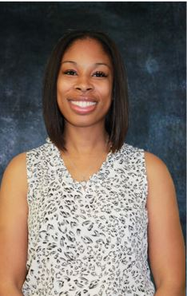
SHERDARRIA
McKISSIC
Association of Student Practical Nurses President
“I plan on furthering my education and applying to the ADN program while continuing to work for Piedmont as a nurse! My ultimate goal is to become a Nurse Practitioner.”

Slide 30
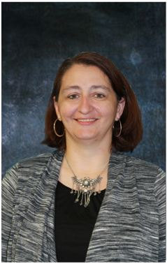
JENNIFER
NICEWANNER
Student Government Association Vice President
“I have plans to earn my nursing degree from Wallace. My career goal is to earn my bachelors degree in Pediatric Nursing."

Slide 31
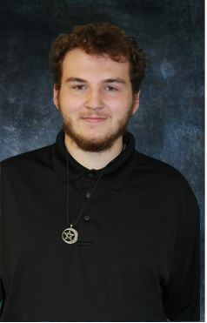
WESLEY
NICEWANNER
Student Government Association Activities Coordinator
“

Slide 32
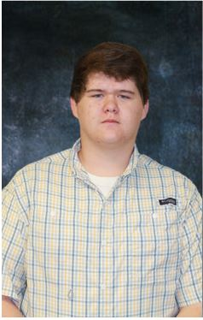
HUNTER PADGETT
Outstanding student in the field of Computer Information Science

Slide 33
JA’RYAN
PARKS
Outstanding student in the field of Business Technologies
Student Government Association Activities Coordinator

Slide 34
ALEXANDER PRICE
Outstanding student in the field of Welding
“

Slide 35
LINDA
REED
Outstanding student in the field of Applied Engineering

Slide 36
NAOMI RIVERA
Outstanding student in the field of Music

Slide 37
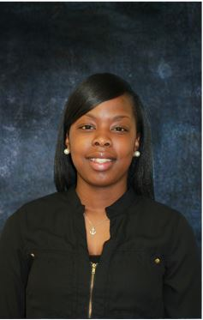
RAKEISHA
RUMPH
Association of Student Practical Nurses Treasurer

Slide 38
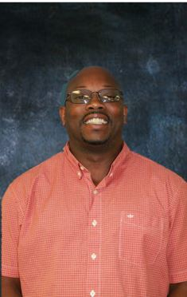
DEXTER
SHAW
Outstanding student in Air Conditioning and Refrigeration
“After I graduate, I plan to find a job in the HVAC field and possibly start my own business in the years to come."

Slide 39
KATIE SMITH
Outstanding student in the field of Literature

Slide 40
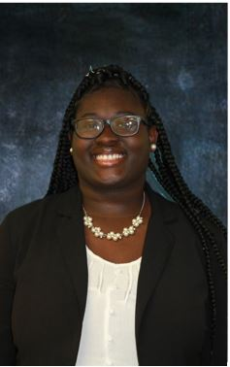
JENECIAH
STARLING
Leadership Development Program Cohort
All Alabama Team Representative
President’s Award Nominee
University of Alabama Community College Distinguished Scholarship recipient

Slide 41
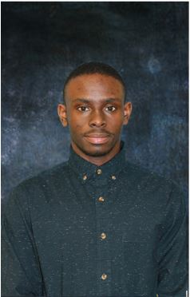
HAROLD STEWART, II
Outstanding student in the field of Music

Slide 42
KALLEN TURNER
Outstanding student in the field of Physical Science I

Slide 43
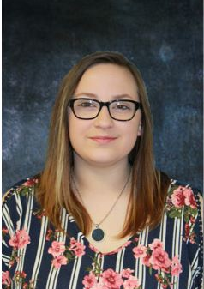
DESIREE
UTLEY
Leadership Development Program Cohort
“I plan to apply for the Radiology Technology program fall 2019.
After graduation, I plan to head straight to work."

Slide 44
ASHYLNN WATFORD
Outstanding student in the field of Licensed Practical Nursing
Outstanding student in the field of Speech
“I am currently in the LPN program with plans to transfer to the ADN program. I hope one day to purse a career as a flight nurse."

Slide 45
JESSICA WEATHINGTON
Outstanding student in the field of Child Development
“

Slide 46
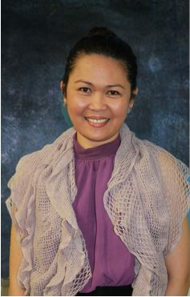
MELCHORA
WESTON
Outstanding student in the field of Human Anatomy I and II
“I plan on completing the ADN program at Wallace followed by continued education in the field of Nursing."

Slide 47
MONICA
WILLIAMS
Phi Theta Kappa Secretary

Slide 48
JADE WOOD
Outstanding student in the field of Composition

Slide 49
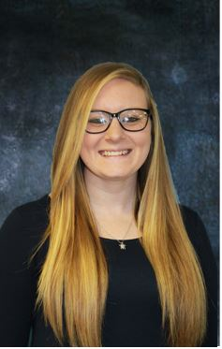
EMILY WURST
Outstanding student in the field of Business Technologies
“I plan to earn my Office Administration degree at Wallace. After graduation, fall 2019 I plan to find a job that uses the skills I have learned in my studies."

Slide 50
MARCOS
YOUNG, JR.
Outstanding student in the field of General Psychology

