Slide 1

Welcome !
Notes:
Good morning . . . and welcome to the Wallace Community College family.

Slide 2

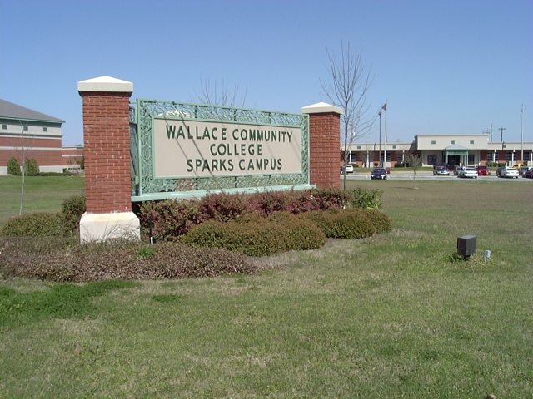
Notes:
Today, Wallace Community College is one of the largest institutions in the Alabama Community College System, serving approximately 4,700 students in credit programs at the Wallace Campus in Dothan and the Sparks Campus in Eufaula.
We also offer instruction at two correctional facilities at Easterling and Ventress prisons in Barbour County. This is done as a state mandate for the rehabilitation of nonviolent prisoners.
Sparks T.C. opened in 1966 and was named for Gov. Chauncey Sparks. Merged in 1999 with WCC.

Slide 3
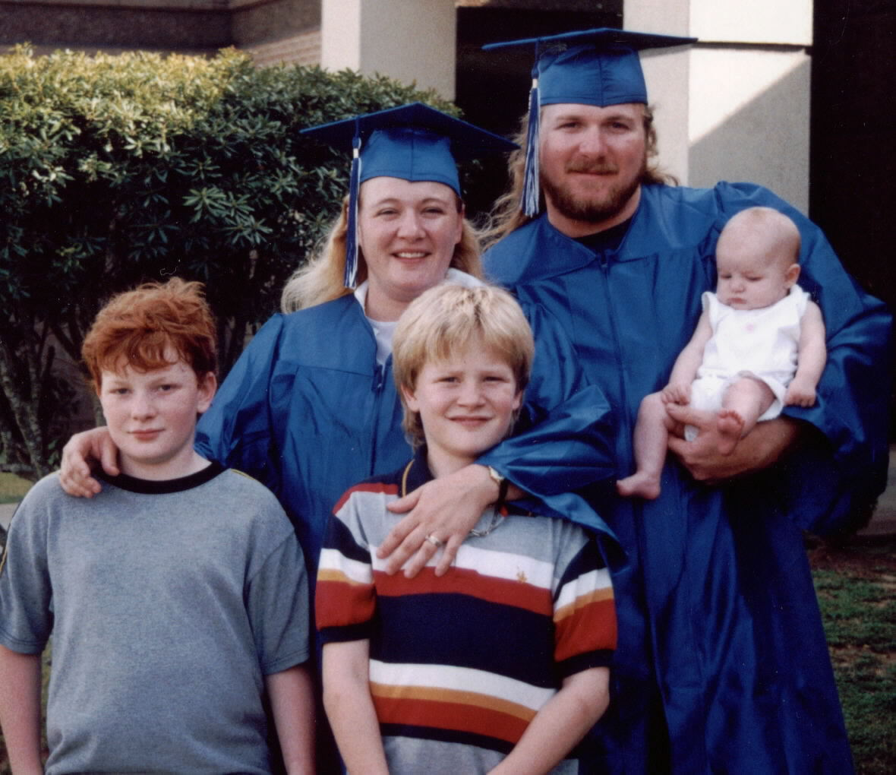
Notes:
The College serves another 2,000 students per year in noncredit programs, such as adult education, at the Center for Economic and Workforce Development Center in Dothan and at the Sparks Campus Workforce Development Center in Eufaula.

Slide 4

Employment Forms
To begin employment at Wallace Community College and to ensure you will receive your paycheck, complete the forms located on the new employee page. For questions about these forms, please contact the Human Resources office.
Note: To view and print each form, click on the links provided or each document.
Employment Eligibility Verification Form (I-9)
The Immigration Reform and Control Act required that all newly-employed individuals provide documents that establish identity and employment eligibility and complete an I-9 form.
Please submit the completed form to the Human Resources office within the first 3 days of your employment. You will be required to provide proper identification, so please read the accompanying instructions when completing the form.
The College will employ only U.S. citizens and persons authorized to work in the United States. Failure to comply with the provisions of the act will result in immediate termination of employment.
A-4 State Income Tax Withholding Form
All employees must sign a A-4 form when they start work. Otherwise, tax will be withheld without exemption
W-4 Income Tax Withholding Form
All employees must sign a W-4 form when they start work. If you do not provide the College with a completed W-4 form, taxes will be withheld at the maximum tax rate of Single and 0 allowances.
Q: Why is Payroll requiring my Social Security Card?
A: Annually, the Payroll Department reports employees' W-2 earnings to the Social Security Administration. Each year a number of employees cannot have their earnings properly credited due to discrepancies in the name and/or social security number being reported. Due to our concern that employees receive proper credit for retirement earnings, the Payroll Department is requiring a copy of the employee's Social Security Card at the time of hire.

Slide 5
Employment Forms
Paycheck
Q: When do I get paid?
A: The last working day of the month
Q: How do I record my time?
A: There are two ways. Full-Time employees should use the Web Time Entry, which is done through the Wallace College Website. Part-Time employees should complete a paper time card, which is done by someone in your department. .
Direct Deposit
What will I need?
Voided Check
OR
Document from bank identifying the following information:
Your Social Security number (e.g. S00000001)
Name on Bank Account
Account Number
Bank Name
Teachers Retirement System form
Must be notarized before submitting

Slide 6
Wallace Community College Policies
It is our responsibility, as employees of the College, to become familiar with the policies that govern our conduct. Please read each of the following policy statements. If you have questions about any of these policies, refer to the list of contacts within the policies or ask your supervisor. The College complies with federal and state regulations including:
Americans with Disabilities Act (ADA)
Wallace Community College provides services and accommodations for students, employees, applicants for employment, and visitors to the College. If you need accommodations to perform the essential functions of your job, please contact Brooke Strickland the Director of Human Resources at 334-556-2418.
Affirmative Action/Equal Opportunity
Wallace is an equal opportunity institution providing educational and employment opportunities without regard to race, color, religion, sex, national origin, age or disability. Inquiries concerning the above, including the application of Title I, Title VI, Title VII, Title IX, or Section 504 may be referred to Human Resources.
Employment Discrimination Policy
The State Board of Education is committed to providing both employment and educational environments free of harassment or discrimination related to an individual’s race, color, gender, religion, national origin, age, disability, or any other protected
class. Such harassment is a violation of State Board of Education policy. Any practice or behavior that constitutes harassment or discrimination shall not be tolerated on any campus or site, or in any division or department, by any employee, student, agent, or non-employee on any institution’s property and while engaged in any institutionally sponsored activities.
Sexual Harassment Avoidance
Wallace is committed to maintaining a fair and respectful environment for living, working, and studying.
Reports of sexual harassment will be met with appropriate disciplinary action, up to and including dismissal
from the College.

Slide 7
Wallace Community College Policies
Professional Responsibility
Wallace Community College employees have basic responsibilities to students, the community, and the general public. Members of the College staff should strive to promote a College environment that fosters personal integrity where the worth and dignity of each human being is realized, democratic principles are promoted, and efforts are made to assist colleagues and students to realize their potential as worthy and effective members of society. Administrators, the faculty, and professional and support staff members are expected to adhere to the highest ethical standards to ensure a professionally functioning institution and to guarantee equal educational opportunities for all students. Employees of Wallace Community College determine the ethical and moral tone for the institution through both personal conduct and job performance. Therefore, each employee should be dedicated to the highest ideals of honor and integrity in all public and personal relationships. Relationships among College personnel of different ranks that involve or give the appearance of partiality, preferential treatment, or improper use of position should be avoided. Romantic relationships that might be appropriate in other circumstances are inappropriate when they occur between a teacher and any student for whom he or she has responsibility, between a College supervisor and an employee, or between a College employee and a student where preferential treatment may appear to result. Further, such relationships may have the effect of undermining the atmosphere of trust on which the educational process depends. Implicit in the idea of professionalism is the recognition by those in positions of authority that in relationships with students or employees an element of power always exists. It is incumbent on those with authority not to abuse, nor seem to abuse, the power with which they are entrusted. All employees of Wallace Community College should be aware that any romantic or otherwise inappropriate involvement with another employee or student makes them liable for formal action against them if a complaint is initiated by the employee or student. Even when both
parties have consented to the development of such a relationship, it is the supervisor in a
supervisor-employee relationship, faculty member in a faculty-student relationship, or employee
in an employee-student relationship who will be held accountable for unprofessional behavior.

