Slide 1
Title IX Training Overview
Shawra Rainer- Student Success Compliance Officer

Slide 2
Meeting Overview
Overview of Title IX Regulations
Possible Changes- New Administration
Overview of ACCS Title IX Training
Clery ACT updates
Case Scenarios

Slide 3
Title IX
Title IX is a federal law that prohibits discrimination on the basis of sex in education programs and activities and employment.
  Covers not only equity in athletic programming, but all forms of discrimination based on sex.
  Protects students and employees.
  Applies to all institutions that receive federal financial assistance, either directly or indirectly
  Enforced by the Office of Civil Rights.

Slide 4
Title IX- Key Provisions
New Title IX regulations were published on May 19, 2020, and took effect August 14, 2020
Requires schools to offer clear, accessible options for any person to report sexual harassment

Slide 5
Title IX- Key Provisions
New Terminology
Training materials publications
What constitutes notice
  Actual knowledge of sexual harassment
    Officials with Authority

Slide 6
Title IX- Key Provisions
Mandatory Dismissal and Jurisdiction
Live Hearing and advisor-led cross examination during the hearing; video and simultaneous access to hearing
Includes faculty and staff

Slide 7
Title IX- Key Provisions
Requires schools to select one of two standards of evidence, the preponderance of the evidence standard or the clear and convincing evidence standard, and to apply the selected standard evenly to proceedings for all students and employees, including faculty
To protect younger students, K-12 schools must respond promptly when any school employee has notice of sexual harassment, including sexual assault. (dual enrolled students)

Slide 8
Pregnant or Parenting-Title IX
Allow a student to continue participating in classes and extracurricular activities even though they are pregnant.
Excuse absences due to pregnancy or childbirth for as long as the doctor says it is necessary.
Allow student to return to the same academic and extracurricular status as before medical leave began, which should include giving the student the opportunity to make up any work missed while out.
Ensure that teachers understand the Title IX requirements related to excused absences/medical leave. A teacher may not refuse to allow a student to submit work after a deadline that’s missed because of pregnancy or childbirth.
If a teacher’s grading is based in part on class participation or attendance and a student missed class because of pregnancy or childbirth, the student should be allowed to make up the participation or attendance.

Slide 9
Title IX - Covers
The new law address only the “Big Five” offenses of sexual harassment, sexual assault, dating violence, domestic violence, and stalking.
Student- Prohibit Discrimination | Employment- Prohibit Discrimination
Admission and recruitment | Employment
Education programs or activities | Recruitment
Housing | Compensation
Facilities | Job Classification
Counseling | Fringe Benefits
Financial and employment assistance | Martial or parental status
Health insurance and benefits | Advertising
Marital or parental status | Pre-employment inquiries
Athletics | Employment criteria
Notes:
Many of the other obligations of the Title IX office, including climate, program equity, athletics, pregnancy, and parenting, LGBTQIA+ protections, etc. are not covered by these regulations, but still fall within the existing original 1975 Title IX regulations, and must be addressed by your Title IX office.
Campus climate surveys to measure the prevalence of sexual assault on campus, assess students’ attitudes and awareness about sexual misconduct and how to report it on campus, and help schools identify ways to address the problem.

Slide 10

NCAA Tournament- Gym Comparison

Slide 11
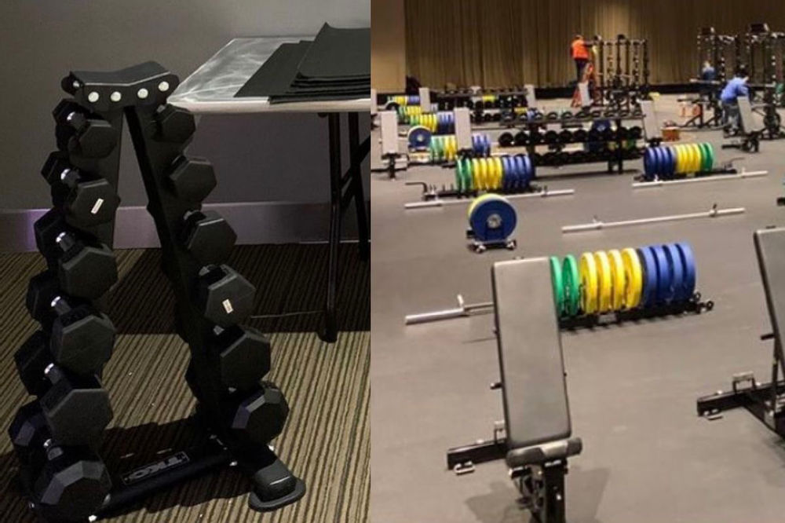
NCAA Tournament-Title IX

Slide 12
CASE STUDY REVIEW

Slide 13
Case Study
Ada continued being touched by Ted before class on her butt and vagina for over a month. During that time, Ada continued to ask Ted to stop touching her. Ted refused and Ada decided to completely stop attending class. She was fearful of what Ted would do next. She began counseling and began having panic attacks anytime she thought Ted was around. Ted began a smear campaign sending messages to the group me, “Class of 2020” telling everyone that Ada was a whore and trying to ruin him.

Slide 14
ATIXA- CASE STUDY
A male student was walking across campus when he heard sounds coming from a window. Approaching the window, he realized it was a ground floor residence hall window, partially open (as were the blinds), and that the sounds coming from the room were sex sounds. He looked in and saw one of his good friends having sex with a female student. He took out his iPhone and began video recording them. As he was recording, an RA walked by and stopped him. When questioned, the student denied sharing the recording with anyone else, and agreed to delete it on the spot at the RA’s request. Both students who were recorded declined to file a complaint, saying they thought it was funny.

Slide 15
ATIXA-VERDICT
Not (Severe, pervasive, objectively offensive) SPOO, even if proven. The fact that both “victims” were not offended could undermine an objective offense conclusion. This conduct was also likely neither pervasive nor unwelcome. It is severe.

Slide 16
ATIXA- CASE STUDY
During class, a Professor assigned homework that required students to watch a show on Netflix that depicts numerous sexual acts (including same sex acts, which the complaining student mentioned as one of their objections to the assignment), nudity, drug use, suicide, marital infidelity, etc. The student found the content to be disturbing. The student is a devout Catholic and was so appalled they went to confession and reported the matter to the Title IX Coordinator. The department chair informed the Title IX Coordinator that the Netflix show did not meet any learning objectives and the professor could have chosen a variety of content through university resources.

Slide 17
ATIXA-VERDICT
Could be SPOO, if proven. Extended and repeated exposure to uncalled for sex-based content could be severe, pervasive, and objectively offensive. The captive audience requirement here enhances the argument for SPOO. While the faculty member has the academic freedom to assign what they want, that’s only true if the assignment is both relevant to the subject matter and educationally appropriate. Here, the department chair’s testimony shows that the content was not within those protections, and an opt-out should have been offered to students, at least.

Slide 18
CLERY

Slide 19
What Is Clery?
It’s a federal statute signed in 1990.
The Clery Act requires all colleges and universities that participate in federal financial aid programs to keep and disclose information about crime on and near their respective campuses.
  The compliance is monitored by the DOE, which can impose penalties, up to 54,789 per violation.
  It can suspend institutions from participating in federal student financial aid programs.

Slide 20
Clery Update
The new rule creates conflicts with the proper enforcement of the Jeanne Clery Disclosure of Campus Security Policy and Campus Crime Statistics Act (Clery Act).
Title IX and Clery share a common purpose of creating a safe campus and equal access to education
Several conflicts between the laws that will ultimately require correction for schools to successfully meet their obligations to protect students.

Slide 21
Clery Update- Advisors
Under the Obama Administration, both the accuser and the accused in Title IX cases had an “advisor of choice” who could provide support, guidance, or advice.
Under the Trump Administration it prevents educational institutions from limiting the choice of who this advisor could be.
Trump administration requires advisors to conduct cross-examinations.
By limiting advisor options for students, the rule undermines a critical support mechanism for both parties violates the spirit of existing law.

Slide 22
Clery- Jurisdiction
The current rule also limits schools to activating their Title IX response as it must occur in the United States and on campus.
  Doesn’t consider the approximate 10% of American college students who participate in study abroad programs
  Establishes inconsistencies where a school can possibly adjudicate some off-campus misconduct, but not under the umbrella of Title IX.
  Contradicts geographical categories established in the Clery Act.
    Which covers off-campus and international properties owned or controlled by student organizations officially recognized by the educational institution.

Slide 23
Clery- Reporting Obligations
The language within the new rule free institutions of their Title IX obligations unless the complainant reports an incident to an “official with authority to institute corrective measures.”
Yet the rule does not offer institutions much guidance as to what roles would fall under this definition.
This presents the risk of isolating Title IX coordinators and campus security authorities, who should instead be encouraged to connect and collaborate to ensure public safety on campus

Slide 24
Clery update (cont.)
NACCOP states it is essential to align Title IX rules and procedures with the Clery Act in order to foster safe, equitable campuses across the nation.
  One in five women and one in sixteen men experience sexual violence during their college years, but it remains the most under reported crime on our campuses

Slide 25
Clery- Settlements
UNC enters into $1.5 million settlement over Clery Act violations, chancellor announces
UC Berkeley reaches settlement to pay $2.35M fine for Clery Act violations

Slide 26
New Administration

Slide 27
Possible Changes- New Administration
Joe Biden named Miguel Cardona the new education secretary.
Biden issued an executive order that requires Cardona to examine the Title IX regulations.
Within 100 days, Cardona must review all the documents to ensure the new regulations doesn’t discriminate of the basis of sex.
  Cardona was directed to consider suspending, revising or rescinding any policies that fail to protect students from discrimination on the basis of sex.

Slide 28
Possible Changes- New Administration
President Biden’s Administration endorses the notion that all students should be protected from discrimination on the basis of sex, including on the basis of sexual orientation or gender identity.
Biden administration will probably require schools’ Title IX policies to expressly extend to discrimination on the basis of sexual orientation or gender identity.

Slide 29
Possible Changes- New Administration
Schools may apply the “clear and convincing” evidence standard when deciding whether sexual misconduct took place on campus.
Contrastingly, the Obama administration required schools to apply the lower “preponderance of evidence” standard.
The hearing and cross-examination requirements conflicted with Obama-era guidance, which discouraged cross-examination.

Slide 30
Title IX Changes- Timeline
Title IX regulations and how quickly changes could occur are unclear.
As seen under the previous administration, the rule-making process is lengthy, and it could take years for a new rule to go into effect.
Groups that supported the previous administration’s changes will almost certainly take action to try to stop changes proposed by the Biden administration

Slide 31
Title IX- Case Review
Lawsuit

Slide 32
Lawsuit- University of Nebraska-Lincoln
A former University of Nebraska-Lincoln student is suing the school for failing to stop a retaliation campaign against her after she reported being sexually assaulted and harassed by a member of the faculty.
  Filed by an international student who pursued a doctorate in UNL
  Faced years of harassment by her adviser
  Reported being pressured to drop her case.

Slide 33
Lawsuit- UNL (continued)
Unidentified faculty member began to sexually harass the student, and at one point, cornered her and kissed her shortly after she started at UNL.
Faculty member was about 60 years old at the time; the student was 26 and married.

Slide 34
Lawsuit- UNL (continued)
Faculty member continued to pursue a romantic relationship with her
  Through inappropriate text messages and recommending she watch a movie where a wife cheats on her husband, and repeatedly hugged her, and told her he loved her
  The student continually refused his advances
    He started a retaliation campaign against her
    Demoting her on a paper she was working on, cutting her research position
    Influencing how other faculty interacted with her

Slide 35
Lawsuit- UNL- Title IX Office Response
Advised to report the faculty member to Title IX Office
Student turned over dozens of emails and documents detailing the ongoing harassment.
According to the complaint, investigators at the office stopped answering her emails and phone calls, and responded in an angry tone when she met face-to-face

Slide 36
Lawsuit- UNL- Title IX Office Response
The Title IX investigators “allegedly” pressured the student to drop her case and not tell anyone about the harassment
Encouraged her to call rather than email the office — possibly to avoid creating public records.
UNL’s Title IX investigators later found the faculty member had violated university policy with regards to sexual harassment.
  According to the complaint, mischaracterized or underplayed several of the incidents of harassment and retaliation against her.
Student pursued a hearing with a faculty panel to reverse her demotion
  She was told by leadership she would lose the university’s support, which she feared could put her student visa status in jeopardy.

Slide 37
Cost of Non-Compliance
The ultimate penalty for non-compliance with Title IX regulations is the withdrawal of federal funds, including monies earmarked for student loans.
With this being at stake, ACCS is taking the necessary steps to ensure all colleges receive the training and certification needed.

Slide 38
ACCS- Title IX Training

Slide 39
Institutional Compliance Solutions
ICS Provides a full range of consulting services for institutions with a specialization in Title IX compliance.
  ICS will provide 11 virtual live group certification training sessions
  All participants of the training will have unlimited access to past recorded webinars, listserv, newsletters, and community share point access

Slide 40
Training Overview
During the third quarter, ACCS will provide online and live Level 1 Certification training through ICS.
During the fourth quarter, ACCS will have a Q&A with ICS. Colleges will implement changes and discuss what’s going well and areas of improvement.
Participants identified for each role will have three days to complete the online training.
Following each online training, there will be a four-hour live training with ICS. At the end of that training, participants will be allowed to ask questions.

Slide 41
Training Overview (continued)
After completing the online and live training participants will receive a certification.
If there are extenuating circumstances and a person cannot attend the live training but completed the online training- they will still receive their certification
Title IX Coordinators are highly encouraged to attend all training as they are providing oversight to all areas.
Other participants will only attend their specific training area.

Slide 42
Title IX Training
Institutional Compliance Solution (ICS) recommends All participants attend Title IX 101 training.
  Foundational Title IX information
  Provide basic Title IX training that will assist with understanding other areas of the training.

Slide 43
Title IX Coordinator- Description
ICS recommends ACCS have at least (1) Title IX Coordinator trained.
Name of Title IX Coordinator Training : Certified Title IX Coordinator Training Level 1
A Title IX Coordinator coordinates and oversee all Title IX compliance efforts for the institution, including responses to reports of sexual harassment, trainings for the campus community and Title IX team, tracking patterns and trends, prevention efforts, and updating policies and procedures.

Slide 44
Title IX Investigator-Description
ICS recommends ACCS have at least (2) Title IX Investigators to receive training.
Name of Title IX Investigator Training: Certified Investigator Level 1
Investigators are neutral and impartial fact-finders who gather evidence regarding an allegation against students, faculty or staff during the investigation. The investigator is responsible for adhering to prescribed timelines throughout the investigation for review of documents and evidence. The investigators are responsible for completing an investigation report at the conclusion of the investigation that fairly summarizes all relevant evidence and information gathered during the investigation. Title IX Investigators must be trained under the new Title IX regulations and will require annual training.

Slide 45
Decision Maker-Description
ICS recommends ACCS have at least (3) Decision Makers receive training.
Name of Title IX Investigator Training: Certified Decision Maker Level 1
Decision makers are responsible for conducting a live Title IX hearing to adjudicate allegations of sexual harassment against students, faculty or staff and/or reviewing appeals of the hearing or a dismissal of a Formal Complaint. For the live hearing, the decision maker is responsible for ensuring that it is conducted in an orderly manner, controlling the conduct of all participants and attendees of the hearing, and rendering a written determination regarding responsibility of the Respondent’s alleged conduct charges in an impartial, neutral, and objective manner. Title IX Decision Makers must be trained under the new Title IX regulations and will require annual training.

Slide 46
Appellate Decision Maker-Description
All participants that receive Decision Maker training will need to receive Appellate Decision Maker training.
Name of Appellate Decision Maker Training: Certified Decision Maker Level- Appeals Level 1
Appeals Decision Maker makes a determination upon an appeal. This person must be trained and serve without bias, conflict of interest, or pre-judgment of fact. This person must understand jurisdiction, definitions, issues of relevance, and how to conduct an appeal.

Slide 47
Advisor-Description
ICS recommends ACCS have at least (2) Advisors trained.
Name of Advisor Training : Certified Title IX Advisor Level 1
Advisors support a Complainant or Respondent through a Title IX process which could be a student, faculty or staff member. Advisors may serve in a limited role during the investigation of a Formal Complaint that may include reviewing the investigation report and attending meetings. Advisors must be provided to parties in a live hearing that adjudicates an allegation of sexual harassment. In the hearing, advisors are responsible for asking questions of other parties or witnesses. In addition to participation in the hearing, this role will likely require meeting with the Complainant or Respondent, reviewing the investigation report and any information or evidence gathered, and preparing questions for the hearing. Advisors are not required to be an attorney.

Slide 48
Informal Resolution Facilitator
ICS recommends ACCS have at least (1) Informal Resolution Facilitator.
Name of Advisor Training : Certified Informal Resolution Facilitator Level 1
Leads an informal resolution process. This is a voluntary, structured interaction between the complainant and respondent to resolve the allegations following the filing of a formal complaint and prior to a formal hearing on the allegations. The Title IX Coordinator may also fulfill the role of the Informal Resolution Facilitator.

Slide 49
Resources
Office for Civil Rights Issues New Resource to Help Education Institutions Implement the Title IX Final Regulations - Part 1 - https://www2.ed.gov/about/offices/list/ocr/docs/qa-titleix-part1-20210115.pdf
Office for Civil Rights Issues New Resource to Help Education Institutions Implement the Title IX Final Regulations - Part 2 - https://www2.ed.gov/about/offices/list/ocr/docs/qa-titleix-part2-20210115.pdf
Questions and Answers Regarding OCR’s Interpretation of Title IX and Single Sex Scholarships, Clubs, and other Programs - https://www2.ed.gov/about/offices/list/ocr/docs/qa-single-sex-20210114.pdf
General FAQ
https://www2.ed.gov/about/offices/list/ocr/frontpage/faq/rr/policyguidance/index.html

Slide 50


Slide 51
THANKS!
Shawra Rainer
shawra.rainer@accs.edu
334-293-4537

