Slide 1
WCC Technology & Online Learning
Orientation 105: Orientation and Student Success

Slide 2
Online Learning

Slide 3
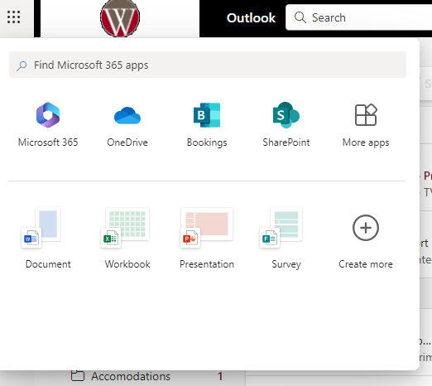
Organizing with Technology
Backup
Location and recurrence
Cloud, external or hard drive
Wallace One Drive
Calendar Integration
Set alerts for due dates, meetings, test, & quizzes, etc.
Use a calendar that you will see daily
Routine
Create to-do lists
Check weekly/daily assignments and due dates
Check your Course Calendar regularly
Review Notes/Study

Slide 4
Success in Online Learning
Be an independent learner: Set Goals
Define learning goals: course, assignment, etc.
Identify what and how to learn to meet your goal
Strategize ways to support your learning
Get the support that you need
Use metacognition: Understand how you learn
Plan
Monitor
Evaluate
Practice Time Management
Organize
Prioritize

Slide 5
Netiquette and Online Communication
Asynchronous: Email, Discussion forums, blogs, texting
Do:
Use correct spelling and grammar
Use subject line wisely
Be brief, concise, and direct
Remain professional
Avoid:
Using all caps or abbreviations
Sending potentially damaging content
Synchronous: Chat, video conferences and meetings
Do:
Use mute/unmute
Close all other apps and sites when screen-sharing
Remember you are on camera
Be aware of recipients when using chat
Avoid:
Multitasking
Looking at yourself when speaking

Slide 6
Getting Tech Ready
Environment | Work/study Location | Outlets, fast and reliable WIFI, Operating hours
Hardware | Computer, modem, router, printer, headset, webcam, speakers, etc. | Gain access to the hardware required in the course syllabus
Browser | Safari, Chrome, Firefox, Microsoft Edge, etc. | Install several internet browsers, keep them updated, use compatible browser for LMS and course content
Software | Operating system, Internet bowsers, Microsoft Office, etc. | Most recent updated version, compatible with course requirements
Plug-Ins | Java, Adobe Reader, Windows Media Player, Quick Time, Microsoft Silverlight, etc. | Download applications that enable you to view media like animations, sound clips, PDFs, etc.
Trouble-Shooting | Address technical issues using the steps to the “5 R’s” process | Reboot (restart) Reinstall (applications/programs) Replug/Reset Reimage Replace

Slide 7

Safety and Security Online
Security
Protect your online identity
Passwords and password managers
Two-Factor Authentication
Security Updates
Antivirus/Anti-malware
Ad Blockers
Backup Often
Privacy
Manage how your personal data is collected and distributed
Request a report of your personal data from data collectors (Google, Facebook, etc.)
Edit and monitor your privacy settings

Slide 8
Quick Review
Remember online learning calls for independent learning
Set goals, use metacognition, and practice time management
Consider the hardware and software you will need to:
Access your course, complete assignments, participate in discussions and lecture
Note that online class does not mean anonymous. Practice good netiquette
Stay organized with your online classes and files

Slide 9
Wallace Username & Password
Wallace User Name and Password are used to access all college technologies
Campus Computer Network
WIFI
My WCC Experience
Wallace Email
Canvas
Wallace User Name
Wallace Student Email address
Provided in your admissions documents upon acceptance to the college

Slide 10
WCC Technology

Slide 11
What is My WCC Experience?
Students can access student registration (when available and view:
Your current courses
Your grades and GPA
Your Degree Plan
Your Current Schedule
Access your Canvas courses
Contact Advisement
View your financial aid dashboard
And much more

Slide 12
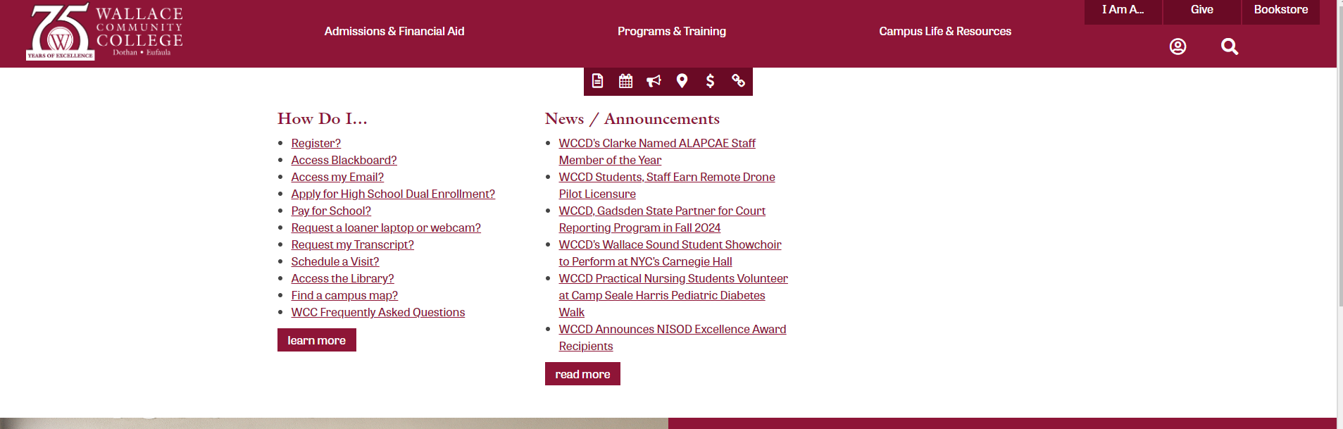
How do I access My WCC Experience?
In the address bar of your browser, type in Wallace.edu which will take you to the Wallace home page

Slide 13
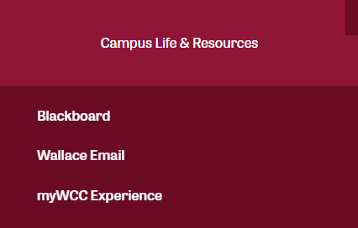
Now click on the Campus Life and Resources Menu at the top of the Wallace Home Page
Once you click on Campus Life and Resources you will see the My WCC Experience Link

Slide 14
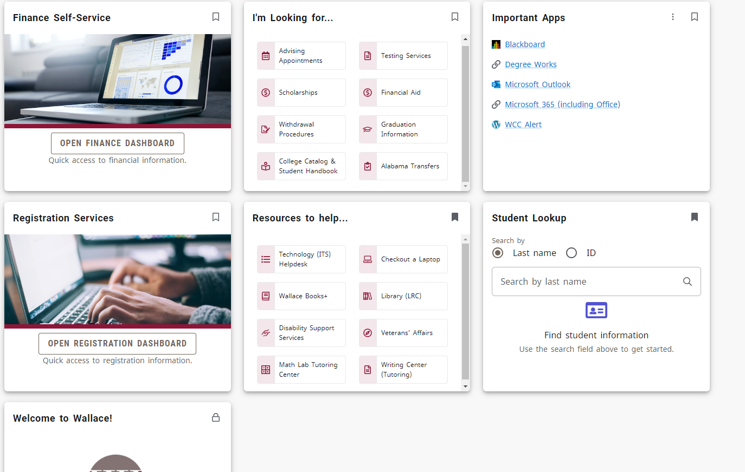
My WCC Experience
Your WCC Experience Page will look similar to the one in the picture above

Slide 15
What Can I Access from MyWCC Experience Account?
Classes you are currently registered for
Current Class Schedule
Advisor
Schedule an appointment with your advisor
Degree Works
Financial Aid Information
Scholarship Information
Canvas
Wallace Email
Register for Future Classes
Learning Resources Center
Writing Center
Math Lab
Wallace Books +
Technology (ITS) Helpdesk

Slide 16
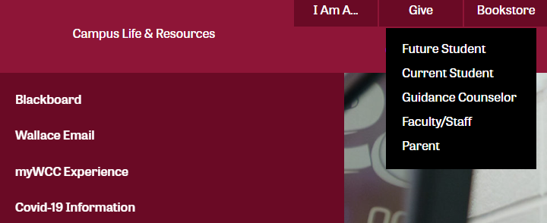
How do I access my WCC Email Account?
All active students at WCC have a student email account.
Click “Wallace Email” under the Campus Life and Resources dropdown menu or “I Am A Current Student, followed by Wallace Email.

Slide 17
Microsoft Office 365
In addition to Wallace Email, students can access several services through this account:
Microsoft Word
PowerPoint
SharePoint
Sway
One Drive
Excel
One Note
Teams
Forms

Slide 18
Login Information
Email Address: Will be you’re A# at alabama.edu
Example:A02127673@alabama.edu
Password: the password you were given in your initial admissions acceptance email or the password you created when you accessed your email

Slide 19
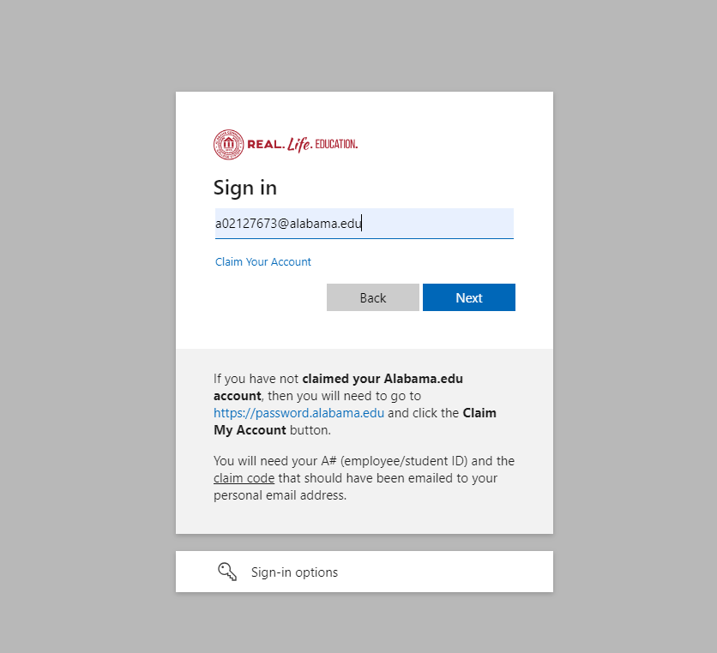
Canvas-Course Management System
To log into Canvas you will use you’re Anumber@alabama.edu like the email address below. Your login information should have been assigned to you in your initial acceptance email. You will use this login user name and password to access all of your Wallace accounts.

Slide 20
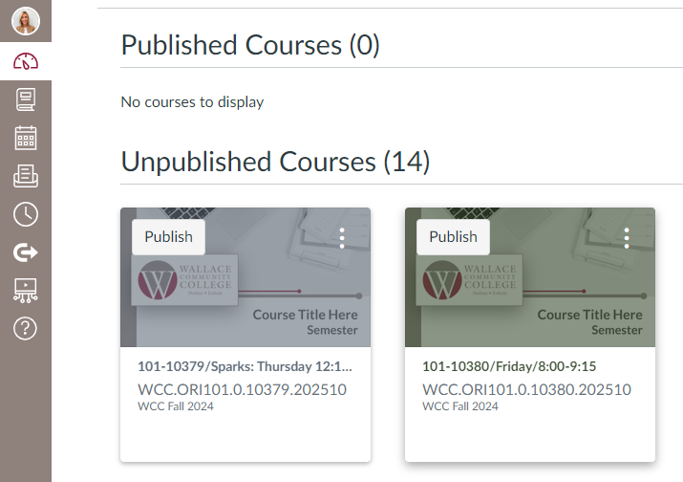
Course Dashboard:
Once you are logged into Canvas you will see your course dashboard. It will look like the picture below. You will click on the ORI course.

Slide 21
Canvas Course Mail
Internal course messaging system
Preferred by many instructors
Students can contact the instructor and other students within each course using Canvas Course Mail
It is NOT the same system as Wallace Email!
Can only be used by others associated with your courses
Financial Aid, Admissions/Records, Student Life Coordinator, Advisors, etc. cannot contact you through Canvas Course Mail

Slide 22
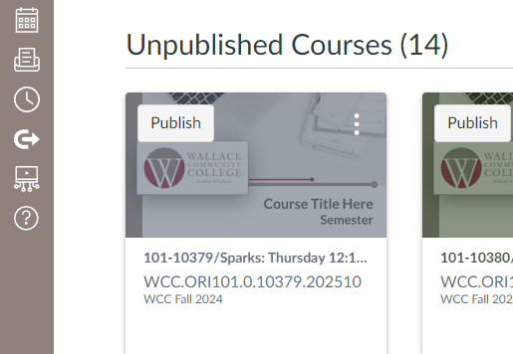
How to access Canvas mail
Locate the Navigation Panel and Click on the Inbox button

Slide 23
Composing Emails and Canvas Messages (course mail) for College Classes
What to Do?
Be Respectful
Use standard English, including correct capitalization, punctuation, and grammar
Be specific and to the point
Check for the correct email address or recipients
Do not forget to include a specific subject in the subject line
Email can end up in the spam folder without a subject and a body

Slide 24
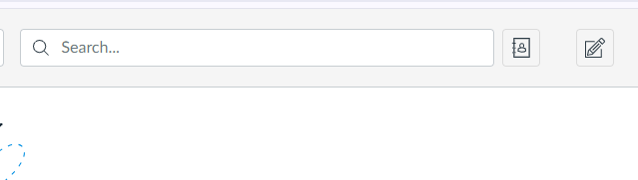
How to create a message within Canvas
Once you are in the Canvas message center, you will click the pencil button.

Slide 25
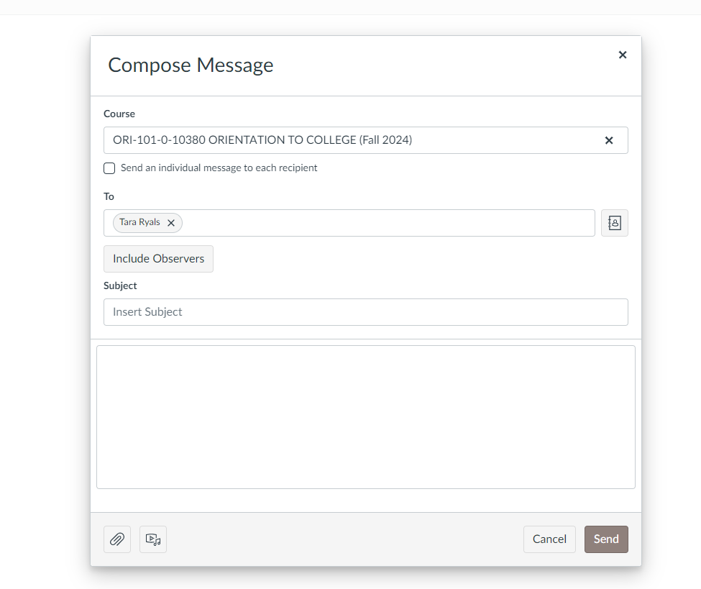
Creating a message in Canvas cont’d.
After you select the pencil icon, you will see a compose message box like the one to the left.
First, you will select the course you are creating the email for
Secondly, you will choose the recipient of the message. If it’s your instructor, select the teacher option, and the instructor’s name will appear.
Lastly, you will include a subject and a message within the message box. If you need to include an attachment, then you will select the paper clip button.
Once your message is complete, you will click send.

Slide 26
Examples of Bad Emails
To: jsmith23@fairmontstate.edu From: rocketgrrl1999@gmail.com
Subject: Assignment
Hey Dr. Smith
Ican’t find my copy of the assignment you was telling us about. Do ya think you could get me another one ASAP?
Thanks bunches!!!
Peace and love, Jenny ♥
Problems: sender email address, subject line, salutation, grammar, abbreviations tone, student name, and the use of emoticons

Slide 27
To: jthomas75@fairmontstate.edu From: jgreen67@students.fairmontstate.edu
Subject: Missing class
Yo! I just wanted to do a heads up about not showing up for class last night. The gf and I got into a fight (again) over $$$ (as always), and I just wanted to let you know why I didn’t show. Can you send me everything I missed?????
Jordan
Problems: subject line, salutation, abbreviations, symbols, student name

Slide 28
To: jdickinson@fairmontstate.edu From: jmichaels32@students.fairmontstate.edu
Subject: Friend
Heya Prof. D—
Imma not going to be able to make it to ur class tomorrow. See, I have a friend I’ve known since we was kids and he’s coming into town tomorrow and I’m going to hang out with him and catch up on old times. He’s visiting family and relatives in our hometown and I haven’t seen him since we was about 10 years old and I won’t get a chance to see him again until who knows when. So, I hope u will forgive me for not being in ur class tomorrow.
Later alligator,
Jeremy # 1
Problems: subject line, salutation, tone, text abbreviations, lengthy explanation/excuse, grammar, ending, student name

Slide 29
Is Wi-Fi available on campus?
WCC has Wi-Fi access points throughout All Wallace Campuses
How can I access Wi-Fi on Campus?
After you have set up your Wallace User Name & Password.
Click Connect to WCC_Student Network
Bring up a browser page. There should be a login page that appears.
Key in your student login information (You Wallace user name and password)

Slide 30
To: jjohnson48@fairmontstate.edu From: smittyboi304@gmail.com
Subject:
Hi Mr. Johnqson! 😊
I hope everything is okay with you, but my computer died. ☹I just wanted to let you know that the assignment we have due tomorrow was on my computer and my brother and my Dad both say that I can’t get it back. Can I get an extension until next week, maybe? It may be longer because I don’t know when I’ll have a chance to get a new one because we are in the process of moving to a new house and everything is kinda up in the air and all over the place! I guess that’s LIFE !!!
Smitty
Problems: sender email address, no subject line, spelling, emoticons, tone, lengthy explanation/excuse, cliché, student name

Slide 31
Whom do I contact with problems?
Information/Assistance:
Information Technology Services Department (ITS).
334-556-2464 or helpdesk@wallace.edu
Submit a Helpdesk Ticket
Helpdesk Location: Computer Technology Center (CTC) Room 118 on the Dothan Campus

